Slide 1
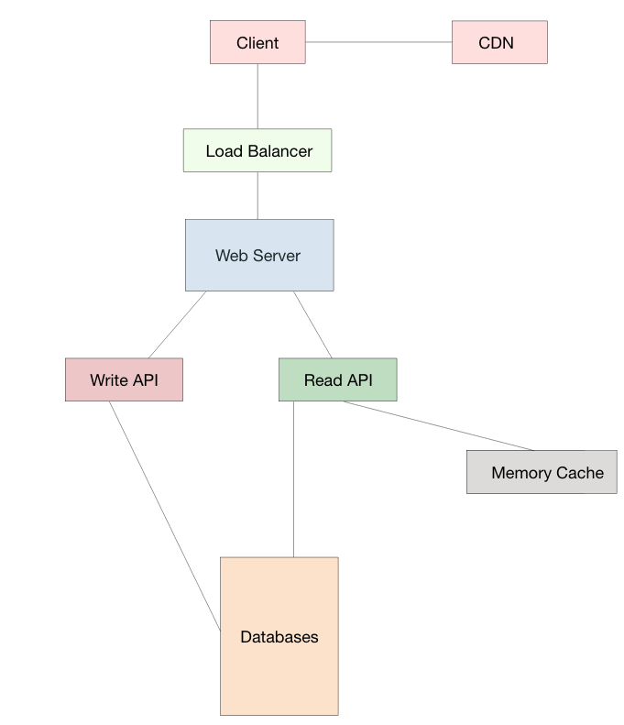


System Design
Systems design is the process of defining the architecture, components, modules, interfaces, and data for a system to satisfy specified requirements.
Before we start designing any system, we must discuss what are the main features this system is going to support.
Then find out all the modules, which will help you in determining API’s and database schema.
Now discuss about how available and consistent your application would be?
Design class diagrams.

Slide 2
Topics We must Know
Client Vs Server
Request Vs Response
Protocols[HTTP, HTTPS, TCP, UDP, Web Socket etc.]
Cloud Hosting and Virtual Machine
Object Oriented Design
Design Patterns
Web API vs Web service
Micro Services Vs Monolithic
Caching
RDBMS[ACID] Vs NoSQL [BASE]
Scaling (Horizontal and Vertical)
Sharding
Consistent Hashing
Availability Consistency(Strong Vs Eventual)
Replication
CAP Theorem
Load Balancer
CDNS
Multi Threading, Concurrency, Locks, Synchronization.
Disk Read Operation [Random Vs Sequential]
CPU, Memory, Hard drive, Network Bandwidth

Slide 3
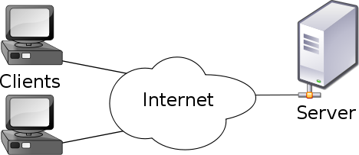
Client and Server
Server: refers to operations that are performed by the server in a client–server relationship in computer networking. Typically, a server is a software program, such as a web server, that runs on a remote server, reachable from a user's local computer or workstation.
Client: refers to operations that are performed by the client in a client–server relationship in a computer network. Typically, a client is a computer application, such as a web browser, that runs on a user's local computer or workstation and connects to a server as necessary.

Slide 4
Cloud Hosting and Virtual Machine
DNS: The Domain Name Systems (DNS) is the phonebook of the Internet. Humans access information online through domain names, like pepcoding.com or google.com. Web browsers interact through Internet Protocol (IP) addresses. DNS translates domain names to IP addresses so browsers can load Internet resources.
Cloud server: is a logical server that is built, hosted and delivered through a cloud computing platform over the Internet. Cloud servers possess and exhibit similar capabilities and functionality to a typical server but are accessed remotely from a cloud service provider.
Virtual Machine: A virtual machine is a computer file, typically called an image, which behaves like an actual computer. In other words, creating a computer within a computer.

Slide 5

Common Protocols
HTTP: It allows you to download data from the internet as well as provides you the privilege to browse web pages on the internet.
HTTPS: It makes use of Secure Socket Layer (SSL) to add an extra feature of security to the network.
TCP/IP: is a suite of communication protocols used to interconnect network devices on the internet. It can also be used as a communications protocol in a private network (an intranet or an extranet
UDP: (User Datagram Protocol) is an alternative communications protocol to Transmission Control Protocol (TCP) used primarily for establishing low-latency and loss-tolerating connections between applications on the internet.
Web Socket: It provides full-duplex communication channels over a single TCP connection. The WebSocket protocol enables communication with lower overhead than half-duplex alternatives such as HTTP polling, facilitating real-time data transfer from and to the server.

Slide 6
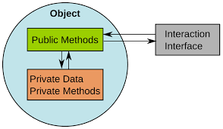
Object Oriented Design
Encapsulation- The implementation and state of each object are privately held inside a defined boundary, or class. Other objects do not have access to this class or the authority to make changes but are only able to call a list of public functions, or methods. This characteristic of data hiding provides greater program security and avoids unintended data corruption.
Abstraction- Objects only reveal internal mechanisms that are relevant for the use of other objects, hiding any unnecessary implementation code. This concept helps developers make changes and additions over time more easily.
Inheritance- Relationships and subclasses between objects can be assigned, allowing developers to reuse a common logic while still maintaining a unique hierarchy. This property of OOP forces a more thorough data analysis, reduces development time and ensures a higher level of accuracy.
Polymorphism- Objects are allowed to take on more than one form depending on the context.

Slide 7
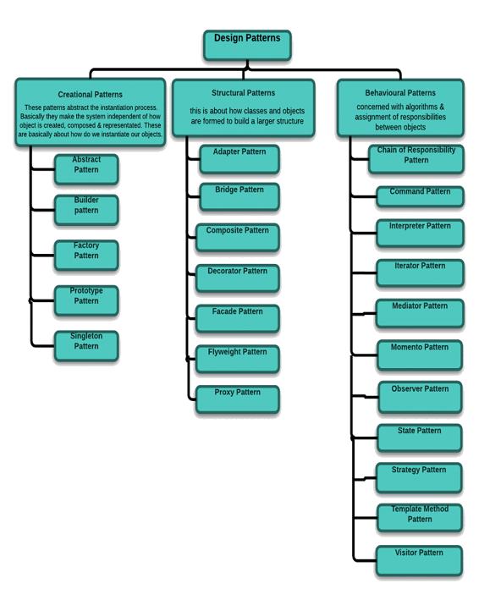

Design Patterns
Design patterns can speed up the development process by providing tested, proven development paradigms.
Effective software design requires considering issues that may not become visible until later in the implementation.
Reusing design patterns helps to prevent subtle issues that can cause major problems.
Improves code readability for coders and architects familiar with the patterns.
Often, people only understand how to apply certain software design techniques to certain problems. These techniques are difficult to apply to a broader range of problems. Design patterns provide general solutions, documented in a format that doesn't require specifics tied to a particular problem.

Slide 8
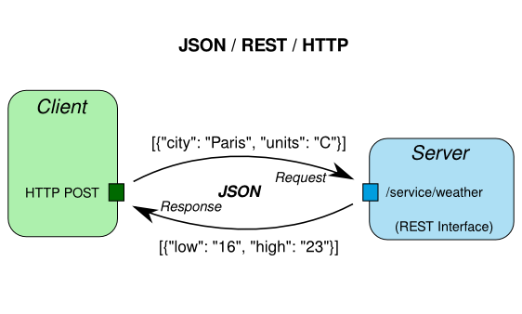

Web API vs Web service
An API exactly defines the methods for one software program to interact with the other.
When this action involves sending data over a network, Web services come into the picture. An API generally involves calling functions from within a software program.
In case of Web applications, the API used is web based.
Desktop applications such as spreadsheets and word documents use VBA and COM-based APIs
1. All Web services are APIs, but all APIs are not Web services.
2. Web services might not perform all the operations that an API would perform.
3. A Web service uses only three styles of use: SOAP, REST and XML-RPC for
communication whereas API may use any style for communication.
4. A Web service always needs a network for its operation whereas an API doesn’t need

Slide 9
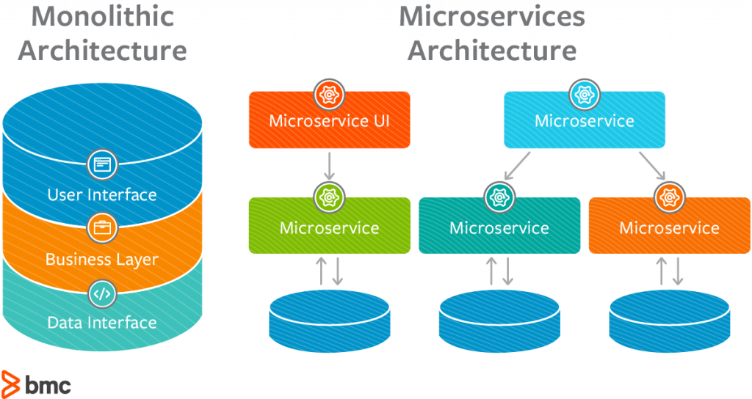


Micro Services Vs Monolithic
Monolithic Architecture: A monolithic application has single code base with multiple modules. Modules are divided as either for business features or technical features. It has single build system which build entire application. It also has single executable or deployable binary.
Microservice Architecture: A microservices architecture consists of a collection of small, autonomous services. Each service is self-contained and should implement a single business capability.

Slide 10
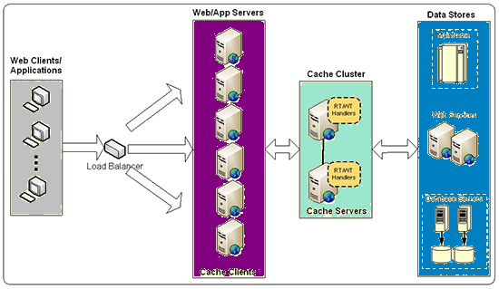
Cache
Cache:
A cache is a memory buffer used to temporarily store frequently accessed data. It improves performance since data does not have to be retrieved again from the original source.
Distributed cache:
When the system gets to certain scale, we need to distribute the cache to multiple machines. The general strategy is to keep a hash table that maps each resource to the corresponding machine. Therefore, when requesting resource A, from this hash table we know that machine M is responsible for cache A and direct the request to M.
Eviction Policy: Eviction policy tries to predict which entries are most likely to be used again in near future, thereby maximizing the hit ratio. The Least Recently Used (LRU) policy is perhaps the most popular due to its simplicity, good runtime performance

Slide 11

RDBMS[ACID] Vs NoSql [BASE]
The key ACID guarantee is that it provides a safe environment in which to operate on your data. The ACID acronym stands for:
Atomic: All operations in a transaction succeed or every operation is rolled back.
Consistent: On the completion of a transaction, the database is structurally sound.
Isolated: Transactions do not contend with one another. Contentious access to data is moderated by the database so that transactions appear to run sequentially.
Durable: The results of applying a transaction are permanent, even in the presence of failures.
For many domains and use cases, ACID transactions are far more pessimistic (i.e., they’re more worried about data safety) than the domain requires. Basic Availability: The database appears to work most of the time.
Soft-state: Stores don’t have to be write-consistent, nor do different replicas have to be mutually consistent all the time.
Eventual consistency: Stores exhibit consistency at some later point (e.g., lazily at read time).

Slide 12
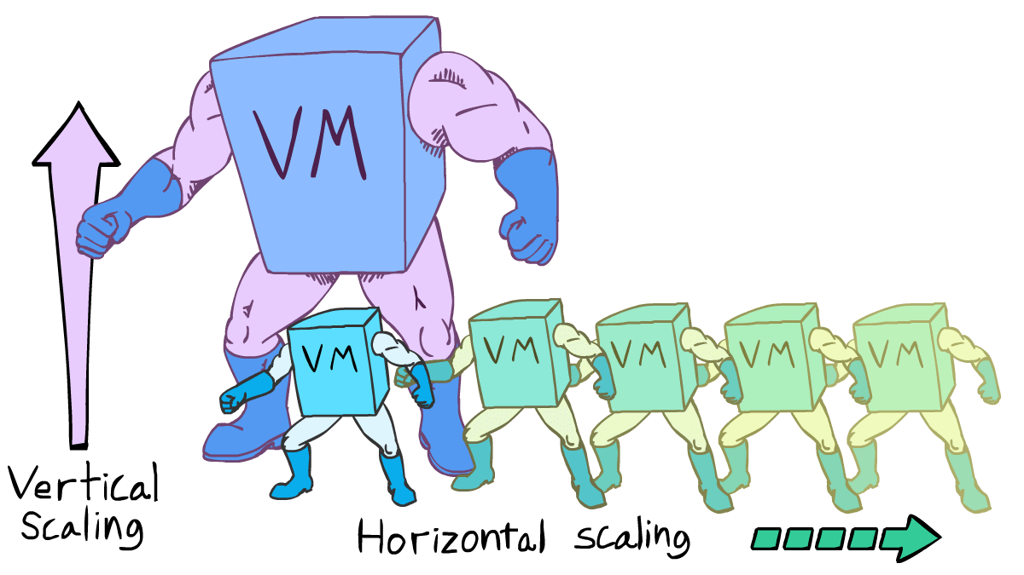
Vertical scaling and Horizontal scaling
Requires Load Balancer
Resilient
Network Calls (RPC)
Data Inconsistency
Scales well as per requirement
N/A
Single Point Of failure
IPC
Consistent
Hardware Limit

Slide 13
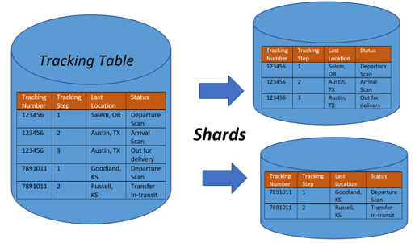
Sharding
Sharding is a type of database partitioning that separates very large databases the into smaller, faster, more easily managed parts called data shards. The word shard means a small part of a whole.
Range Based Sharding
Key Based Sharding(Hash based sharding)
Directory Based Sharding

Slide 14
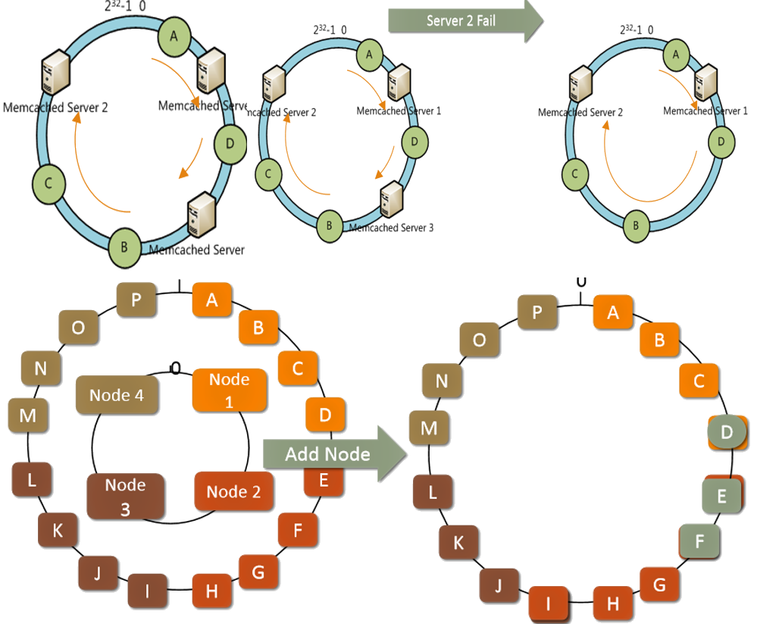
Consistent Hashing
Consistent hashing allows you to scale up and down easier and makes ensuring availability easier. Easier ways to replicate data allows for better availability and fault-tolerance. Easier ways to reshuffle data when nodes come and go means simpler ways to scale up and down.

Slide 15
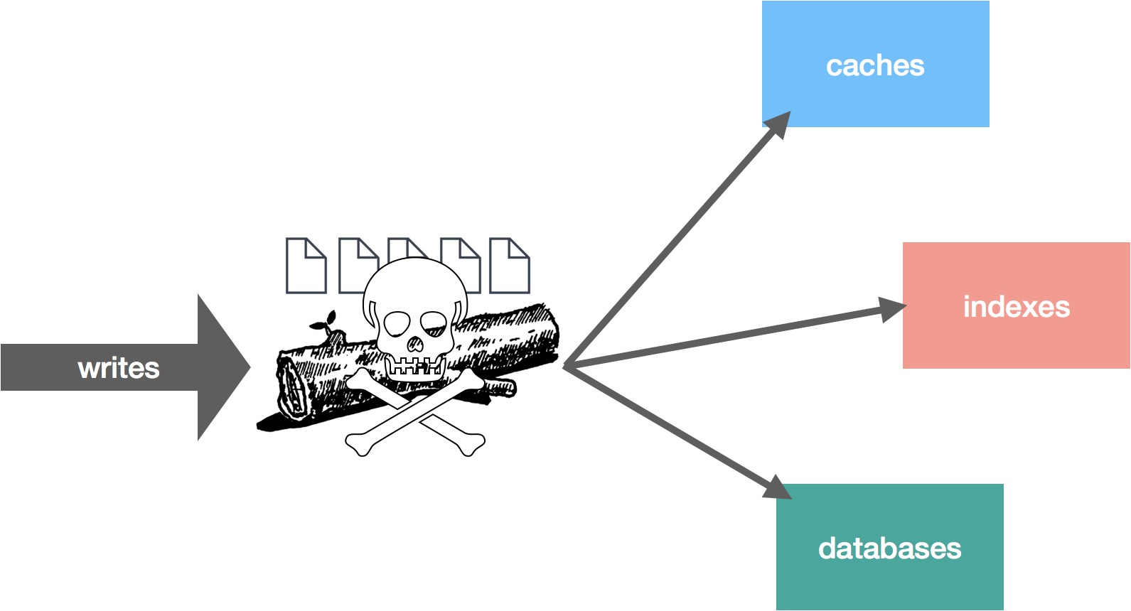
Consistency
Eventual Consistency: Whenever we use multiple replicas of a database to store data and let’s say a write request comes to one of the replicas. In such a situation, Databases had to discover a strategy to make this write request at one replica reach other replicas so that they all could also write data of the request and become consistent.
Strong Consistency: It says data will get passed on to all the replicas as soon as a write request comes to one of the replicas of the database. But during the time these replicas are being updated with new data, response to any subsequent read/write requests by any of the replicas will get delayed as all replicas are busy in keeping each other consistent.

Slide 16
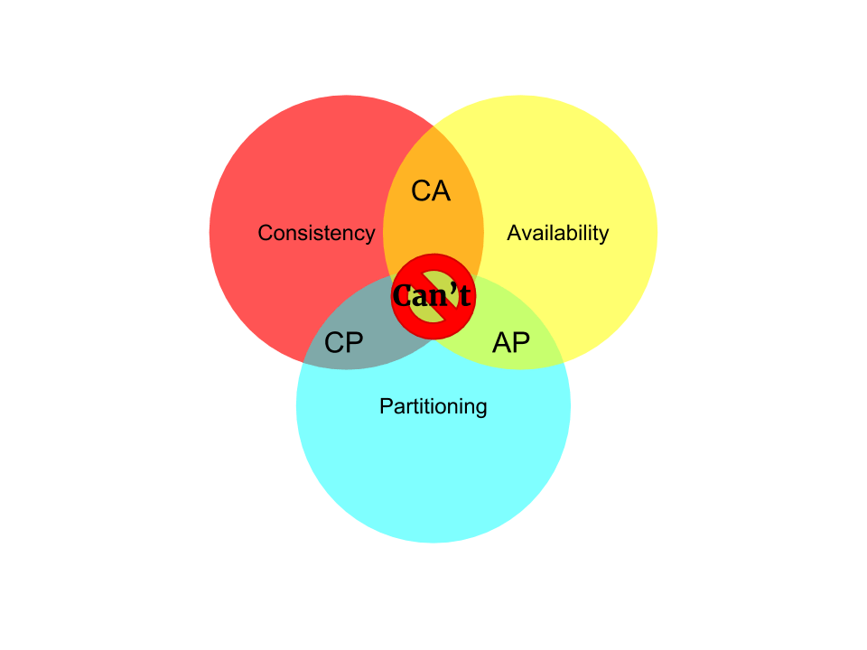
CAP Theorem
CAP theorem, is also named Brewer's theorem after computer scientist Eric Brewer, states that it is impossible for a distributed data store to simultaneously provide more than two out of the following three guarantees.
Consistency: every read receives the most recent write or an error
Availability: Every request receives a (non-error) response – without the guarantee that it contains the most recent write
Partition Tolerance: The system continues to operate despite an arbitrary number of messages being dropped (or delayed) by the network between nodes.
No distributed system is safe from network failures; thus network partitioning generally has to be tolerated. In the presence of a partition, one is then left with two options: consistency or availability.
CAP is frequently misunderstood as if one always has to choose to abandon one of the three guarantees. In fact, the choice is really between consistency and availability only when a network partition or failure happens; at all other times, no trade-off has to be made
Database systems designed with traditional ACID guarantees in mind such as RDBMS choose consistency over availability, whereas systems designed around the BASE philosophy, common in the NoSQL movement for example, choose availability over consistency.

Slide 17
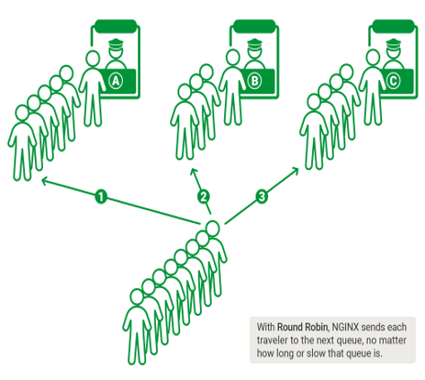
Load Balancer
Load balancing refers to efficiently distributing incoming network traffic across a group of backend servers, also known as a server farm or server pool.
Round Robin – Requests are distributed across the group of servers sequentially.
Least Connections – A new request is sent to the server with the fewest current connections to clients.
IP Hash – The IP address of the client is used to determine which server receives the request.

Slide 18

Practice Designs Videos
Design a service like Tiny URL[ Tushar Rai]: https://www.youtube.com/watch?v=fMZMm_0ZhK4
Autocomplete or Typeahead Suggestions for Google search: Tushar Rai https://www.youtube.com/watch?v=us0qySiUsGU
Architecture for auto suggestions [ Narendra L]:
https://www.youtube.com/watch?v=xrYTjaK5QVM&list=PLkQkbY7JNJuBoTemzQfjym0sqbOHt5fnV&index=9&t=0s
Messaging/chat service like FB or WhatsApp [ Tushar Rai]: https://www.youtube.com/watch?v=zKPNUMkwOJE
Twitter system design [Narendra L]: https://www.youtube.com/watch?v=wYk0xPP_P_8&list=PLkQkbY7JNJuBoTemzQfjym0sqbOHt5fnV&index=4&t=0s
Uber System design [Narendra L]: https://www.youtube.com/watch?v=umWABit-wbk&list=PLkQkbY7JNJuBoTemzQfjym0sqbOHt5fnV&index=7&t=54s
System Design Shopify eCommerce: https://www.youtube.com/watch?v=lEL4F_0J3l8&list=PLA8lYuzFlBqAy6dkZHj5VxUAaqr4vwrka&index=9&t=0s

Slide 19
Good reads From GFG and Interview bit
https://www.interviewbit.com/problems/sharding-a-database/
https://www.interviewbit.com/problems/design-cache/
https://www.interviewbit.com/problems/highly-consistent-database/
https://leetcode.com/discuss/interview-question/system-design/200342/Bloomberg%3A-Implement-a-system-to-track-runners-in-a-marathon
https://www.geeksforgeeks.org/design-scalable-system-like-foursquare/
https://www.geeksforgeeks.org/design-video-sharing-system-like-youtube/
https://www.geeksforgeeks.org/design-movie-ticket-booking-system-like-bookmyshow/
https://www.geeksforgeeks.org/design-online-hotel-booking-system-like-oyo-rooms/
https://www.geeksforgeeks.org/design-parking-lot-using-object-oriented-principles/
https://www.geeksforgeeks.org/design-scalable-system-like-instagram/
https://practice.geeksforgeeks.org/problems/design-a-solution-to-find-the-most-visited-product-in-last-2-hours-sliding-window-problem-to-find-n
https://medium.com/system-designing-interviews/design-a-elevator-system-fc5832ca0b8b
https://www.geeksforgeeks.org/design-an-online-book-reader-system/

